Slide 1
Exploration of Eagleford Shale Performance Drivers and Performance Prediction in De Witt and Karnes County
Hart Greenwood 6/15/2020
GA-DATR-April 2020 Class

Slide 2
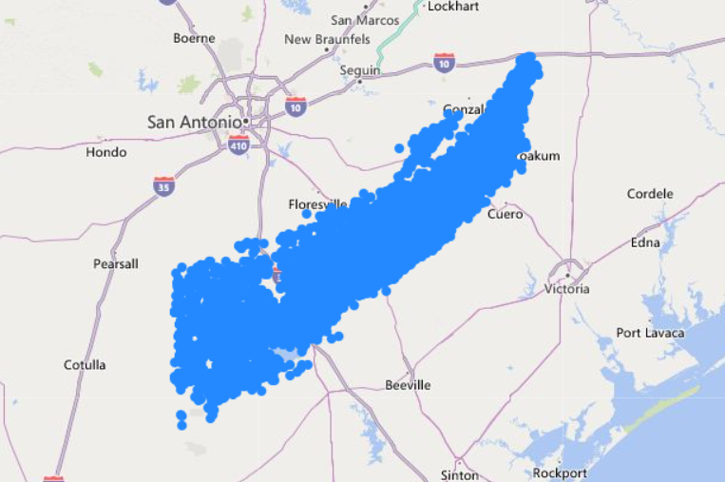
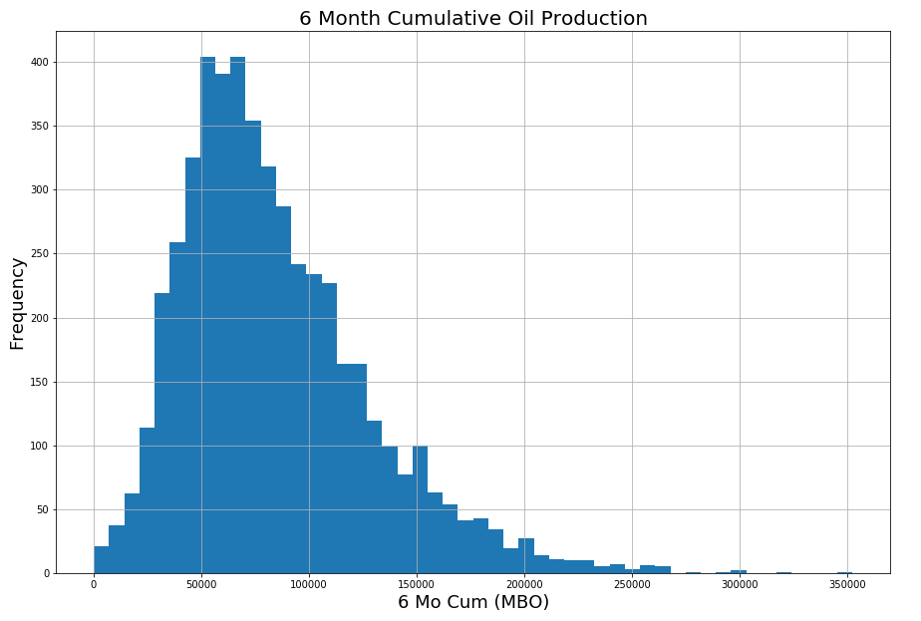
Original Dataset Map
Gathered data from IHS (publicly provided information)
Original Dataset Contained data from 11,175 wells across De Witt and Karnes County
Two of the most prolific counties in the play
Covers a wide range of operators, fluid types, and completion types
Target Variable is 6 month cumulative oil production
I want to understand what drives the well performance of infill oil wells

Slide 3
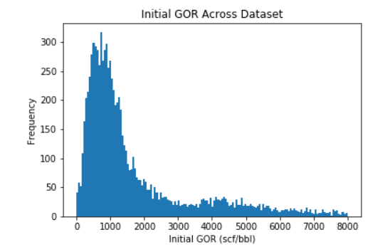
Original Dataset and Preliminary Cleanup
Collected production, drilling, and completion data
Cleaned the dataset down to wells with completion data, at least 6 months of production, and with GOR’s less than 1500 scf/bbl
Without the GOR filter, TVD and GOR will dominate production rates
Iterated through the dataset and looked for the oldest well in the unit (the parent well) and pulled the cumulative production and 6 month production volume
This should act as a proxy for “depletion” and geologic strength of the unit
Measured the distance between each well in the dataset and returned the closest distance – well spacing is generally a strong performance driver
Calculated the length of the horizontal lateral, well completion metrics, and geohash location (“zip codes for location”)
Final Dataset contains about ~4900 wells
<1500 scf/bbl GOR: Black Oil
1500 scf/bbl < GOR <3200 scf/bbl: Volatile Oil
>3200 scf/bbl: Gas Condensate
<1500 scf/bbl GOR: Black Oil
1500 scf/bbl < GOR <3200 scf/bbl: Volatile Oil
>3200 scf/bbl: Gas Condensate
Drilled 8/1/2014
Drillled 1/1/2019
300’
Infilled Section

Slide 4
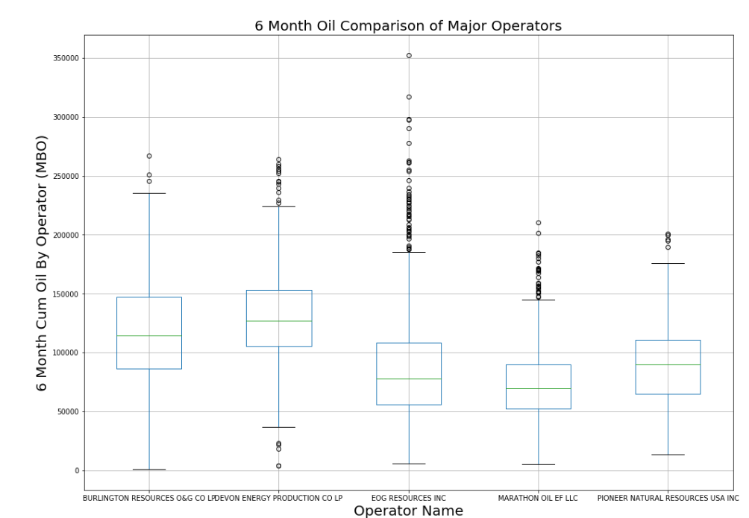
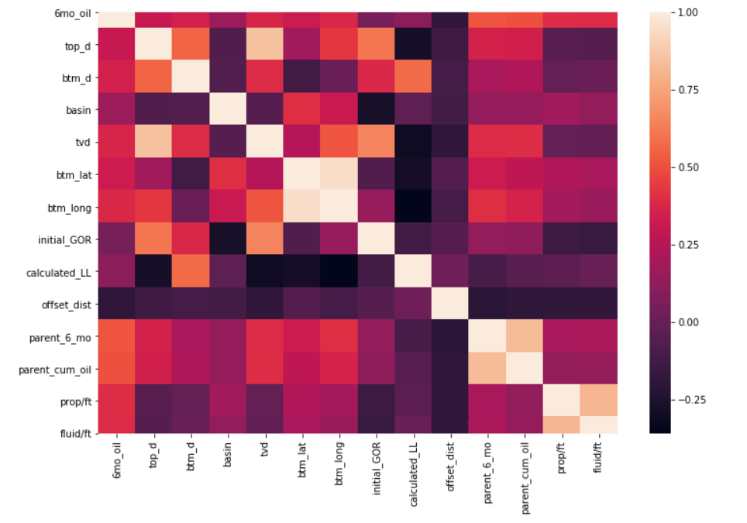
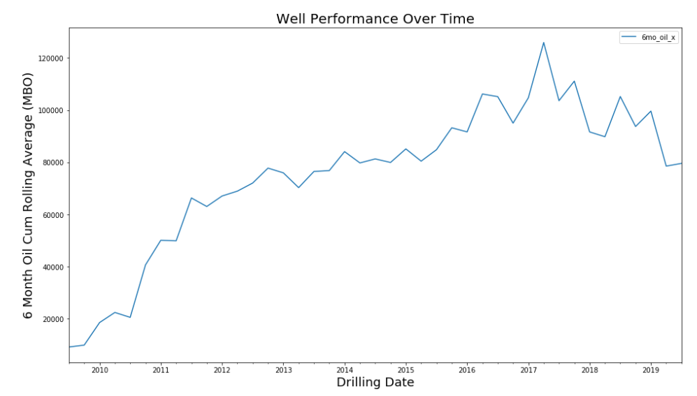
Data Exploration and Analysis
Compared the 5 major Operators
Reviewed the performance delta between the two geologic basins that make up the dataset
Karnes Embankment appears to perform slightly better than the Rio Grande Trend
Reviewed the general trends in completion design, well spacing, and lateral length
Compared correlation to the target variable (6 month cumulative oil) and looked for multicollinearity
Parent cumulative volume and 6 month cumulative volume highly correlated (r² = .8)
Fluid pumped per foot and proppant pumped per foot highly correlated (r² = .8)
Strongest predictor of performance appears to be parent performance, completion size, and depth

Slide 5
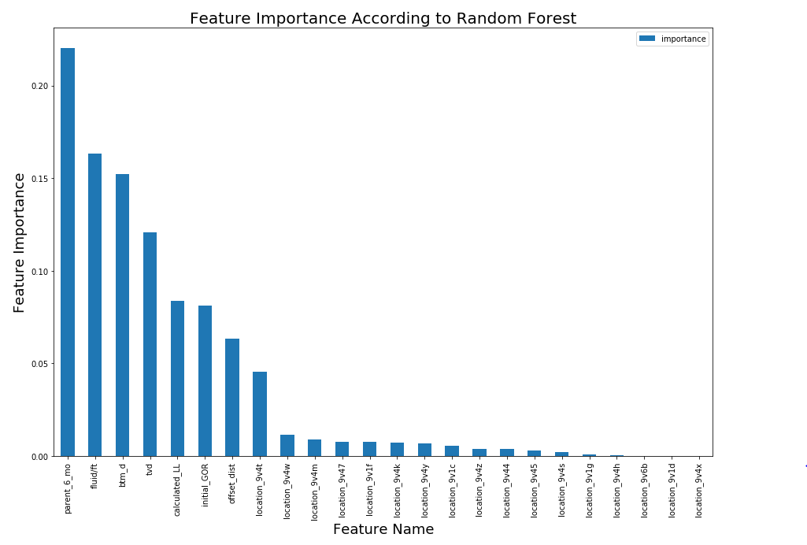
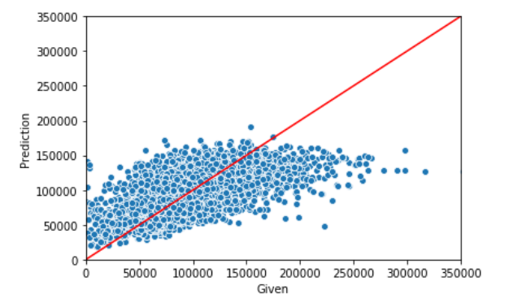
Modeling Effort
Attempting to predict 6 month well performance using:
Completion Size, location, parent performance, lateral well spacing, and depletion (simplified)
Dumb model RMSE: 43,683 bbls (pretty significant considering the mean is 84,300 bbls)
Started with simple linear regression and adjusted features
Max R^2 = .5
Scaled the data and used a linear regression model and viewed the feature coefficients to understand how important each feature truly is
Depth, completion size, and parent performance seem to be the biggest drivers among all model types
Attempted Decision tree and adjusted max tree depth for tuning
Attempted XG Boost and CatBoost
Best performing model: Random Forest
Cross validated with 6 kfolds
Tuned hyperparameters and increased R² from .6 to .66
Random Forest Predicted 6 month Cum vs Actuals
Model | Test R^2 | Test RMSE
Basic LR | 0.52 | 30,800
LR w/ Feature Exploration | 0.465 | 32,570
Basic Decision Tree | 0.3 | 34,000
Bagging Regressor | 0.59 | 27,550
XG Boost | 0.53 | 29,490
Cat Boost | 0.55 | 28,913
Random Forest | 0.657 | 25,480

Slide 6
Issues, Future Work
Obviously this model doesn’t perfectly predict well performance
To be fair, this is the closest model I’ve seen over such a large area
I would have liked to have tuned additional hyperparameters but run time was proving to be the limiting factor
Possible Improvements:
Simple geologic inputs such as thickness would really benefit
Stage count is usually a big driver but that information is not public
More trustworthy data in general would probably be helpful – much of the data was trimmed in an attempt to clean up missing/erroneous data
Interesting Finds:
Regardless of the model precision, certain key drivers are very interesting
Generally, lateral length and offsetting well spacing are larger performance drivers
These two factors can make up 50% of the variance in other plays
The parent well depletion actually had a positive correlation with performance – this only occurs in the Eagleford
Random Forest Predicted 6 month Cum vs Actuals

